Slide 1

Introduction
Have you ever wondered how Netflix works as a bigger system ?
Netflix is a popular streaming platform. It allows us to watch movies and TV shows anytime, anywhere.

Slide 2
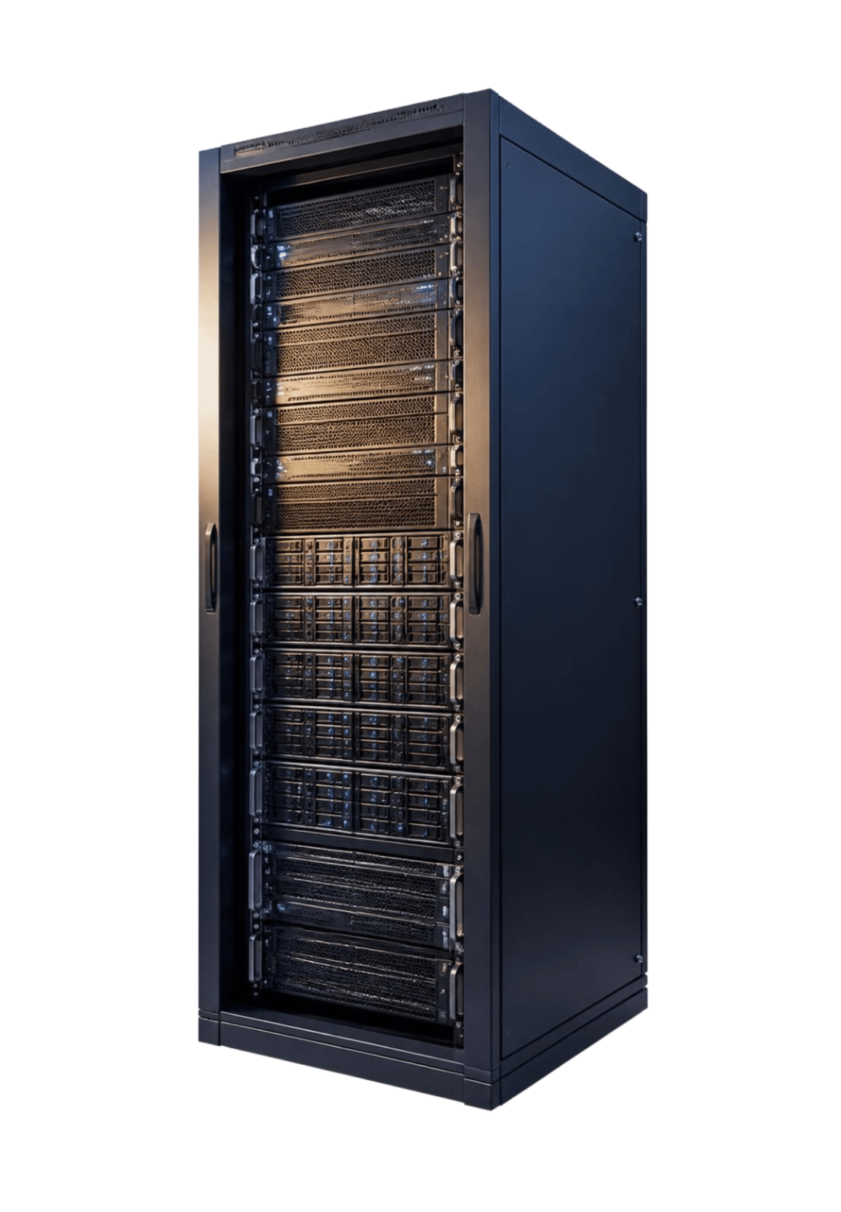
How Does Netflix Store and Stream Videos?
01
First, Netflix stores its videos on powerful servers and cloud systems.
02
When we choose a movie, the app sends a request to its servers.
03
Then, the video is sent to our device through the internet. It loads in small parts, so we can start watching before the whole video downloads.

Slide 3

How Does Netflix Recommend Movies?
01
Netflix also uses Artificial Intelligence to recommend movies and shows.
02
It learns from our watching habits, such as what we watch and what we like.
03
Then, its recommendation system suggests content we may enjoy.

Slide 4
Conclusion
A large apps like Netflix combine servers, cloud technology, the internet, and Artificial Intelligence.
All these technologies work together to give us a smooth and personalized experience.
Thank you for listening.

